Slide 1
Lecture 10
DTMC – Steady State Analysis

Slide 2
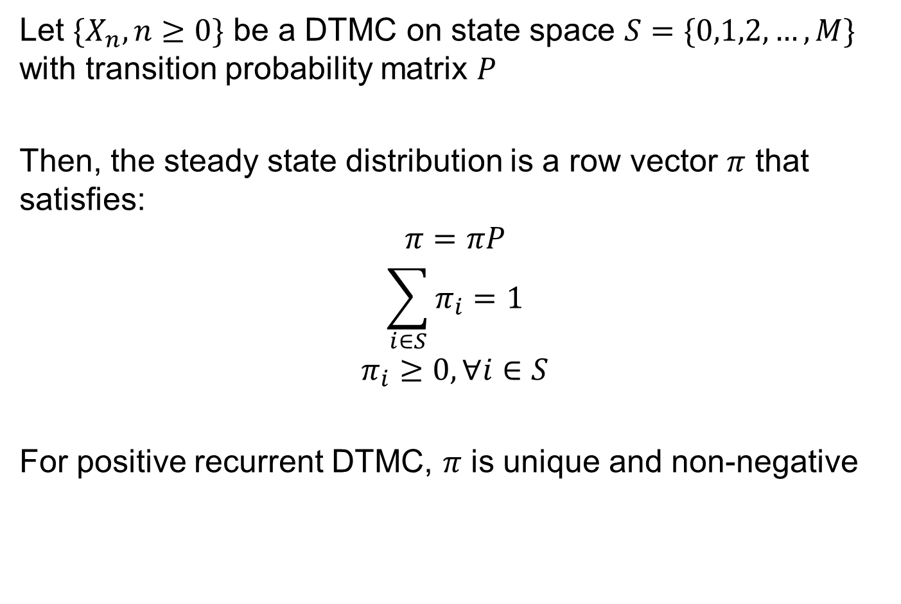
Steady State Distribution
Let $\{X_{n},n≥0\}$ be a DTMC on state space $S=\{0,1,2,…, M\}$ with transition probability matrix $P$
Then, the steady state distribution is a row vector $π$ that satisfies:
$$π=πP$$
$$\sum_{i∈S}{π_{i}}=1$$
$$π_{i}≥0, ∀i∈S$$
For positive recurrent DTMC, $π$ is unique and non-negative

Slide 3
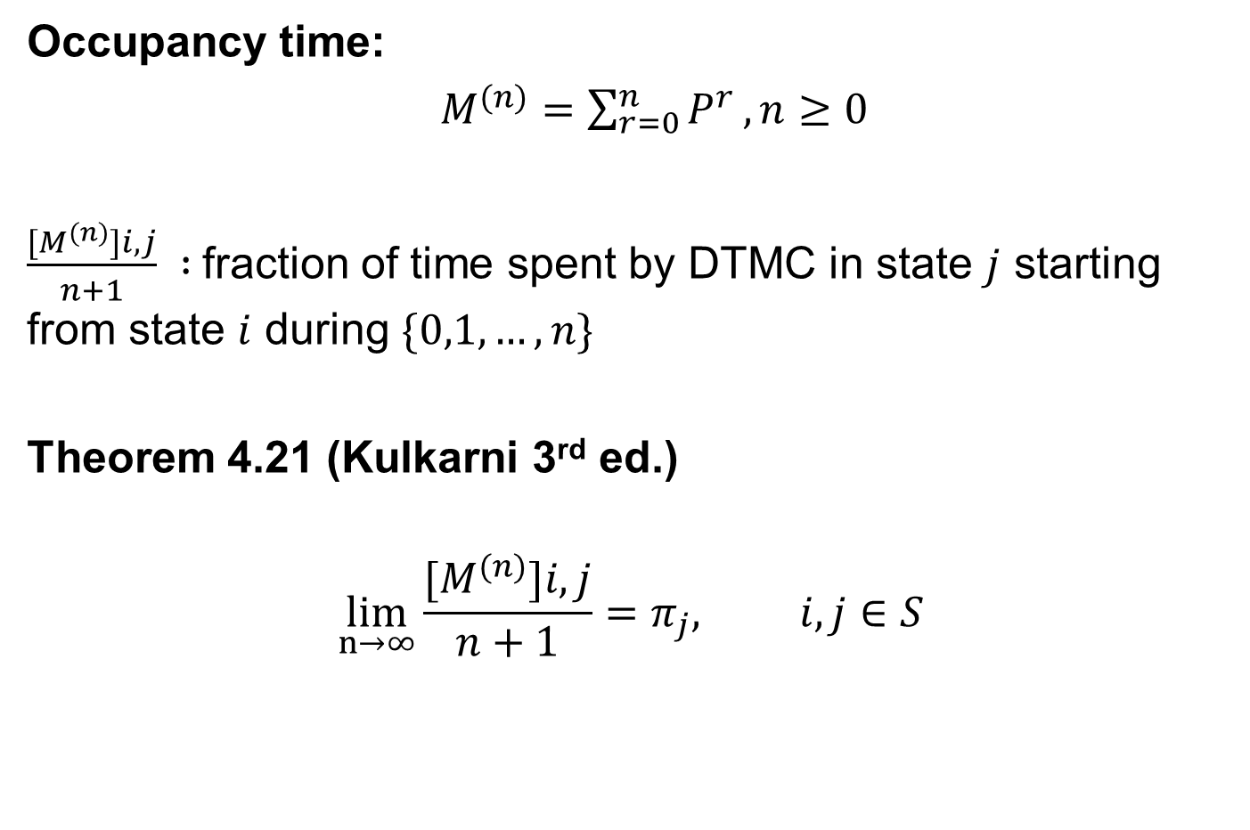
Limiting Occupancy Distribution
Occupancy time:
$M^{(n)}=\sum_{r=0}^{n}{P^{r}},n≥0$
$\frac{{[M}^{(n)}]i,j}{n+1} :$fraction of time spent by DTMC in state $j$ starting from state $i$ during $\{0,1,…,n\}$
Theorem 4.21 (Kulkarni 3rd ed.)
$$\lim_{n→∞}\frac{{[M}^{(n)}]i,j}{n+1}=π_{j}, i,j∈S$$

Slide 4


Equations to Solve
Consider a transition probability matrix:
Now lets list the equations to solve to find $π:$
$$π\left(I−P\right)=0$$
$$\left[π_{0},π_{1},π_{2}\right]\left[\begin{matrix}0.4 & −0.3 & −0.1 \\ −0.8 & 0.8 & 0 \\ −1 & 0 & 1\end{matrix}\right]=0$$
0.6 0.3 0.1
0.8 0.2 0
1 0 0
$$P=$$
And what else??

Slide 5

Example
Consider an example with 2 computers. Computer repair process has 3 states
0 (No computers have failed)
1 (One computer failed)
2 (Both computers failed)
Transition Matrix is given by:
0.6 0.3 0.1
0.8 0.2 0
1 0 0
$$P=$$

Slide 6
Example – Question 1
Is this DTMC irreducible?
Is this DTMC periodic or aperiodic? Does a steady state solution exist?

Slide 7


Example – Question 2
What happens to $π$ when we change transition probability to:
$$π\left(I−P\right)=0$$
$$\left[π_{0},π_{1},π_{2}\right]\left[\begin{matrix}0.4 & −0.3 & −0.1 \\ −0.8 & 0.8 & 0 \\ 0 & 0 & 0\end{matrix}\right]=0$$
0.6 0.3 0.1
0.8 0.2 0
0 0 1
$$P=$$

